Slide 1
can Boruta help US to build more accurate and efficient Supervised model?
Aldo Gadra Paulus Simatupang

Slide 2
Introduction
Heart attack, as with other medical related cases, is an important feature especially regarding it severity.
Machine Learning can help this matter by building detection measure to assets risk and diagnoses.
In this study, we will explore on how should we design variable in the supervised model to find the most accurate model.

Slide 3
Data feature
Age : Age of the patient
Sex : Sex of the patient
exang: exercise induced angina (1 = yes; 0 = no)
ca: number of major vessels (0-3)
cp : Chest Pain type chest pain type
Value 1: typical angina
Value 2: atypical angina
Value 3: non-anginal pain
Value 4: asymptomatic
target : 0= less chance of heart attack 1= more chance of heart attack
trtbps : resting blood pressure (in mm Hg)
chol : cholestoral in mg/dl fetched via BMI sensor
fbs : (fasting blood sugar > 120 mg/dl) (1 = true; 0 = false)
rest_ecg : resting electrocardiographic results
Value 0: normal
Value 1: having ST-T wave abnormality (T wave inversions and/or ST elevation or depression of > 0.05 mV)
Value 2: showing probable or definite left ventricular hypertrophy by Estes' criteria
thalach : maximum heart rate achieved
Data source: https://www.kaggle.com/rashikrahmanpritom/heart-attack-analysis-prediction-dataset

Slide 4
Feature selection Boruta
Boruta uses random forest principle with added reshuffle data to create shadow feature. This algorithm eliminates feature that have worst importance.

Slide 5
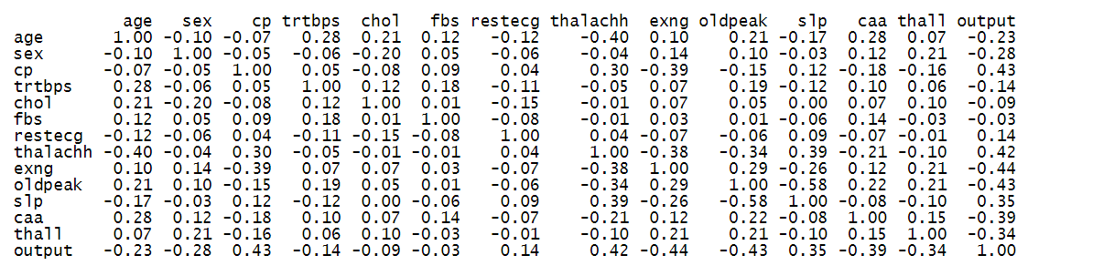
Variable Correlation
There is no multicollinearity indicated by the lack of correlation more than 0.8. Therefore Boruta feature selection can be implemented.

Slide 6
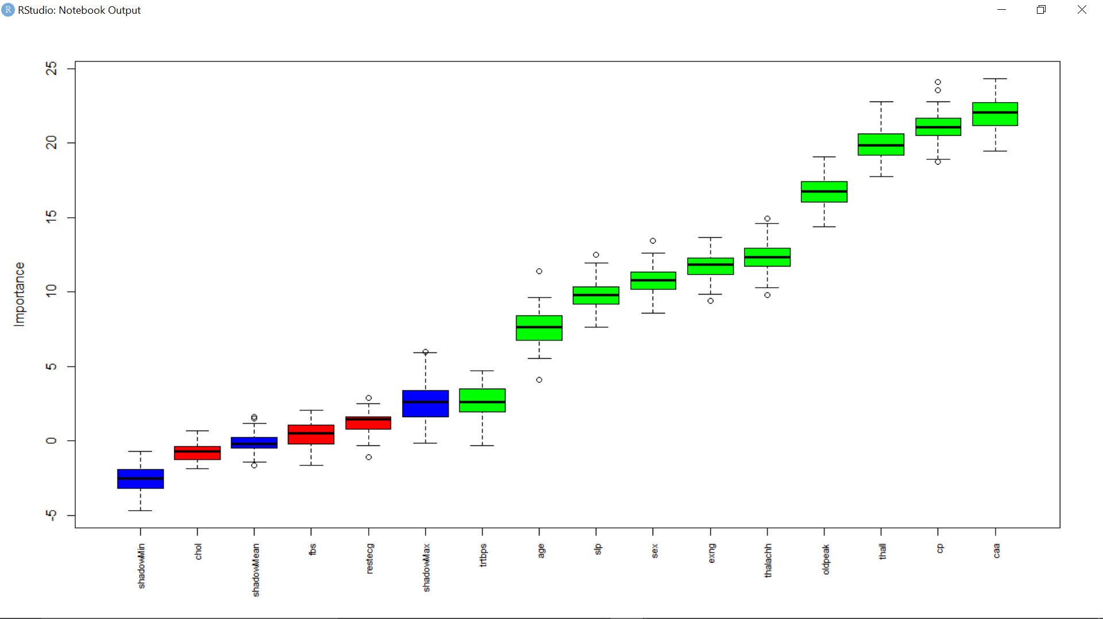
Boruta Analysis

Slide 7
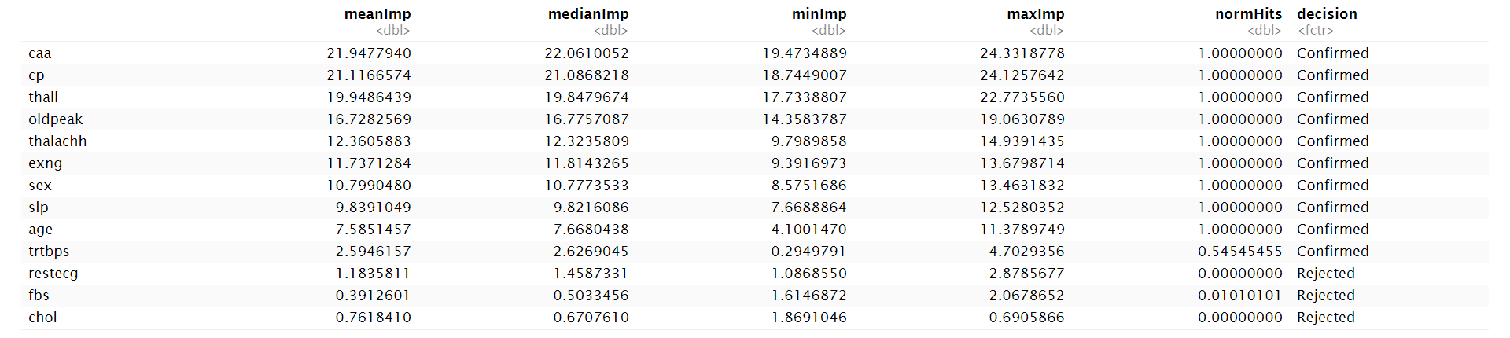
Boruta Analysis

Slide 8
Model
Model 1: caa+cp+thall+oldpeak
Model 2: caa+cp+thall+oldpeak+thalachh
Model 3: caa+cp+thall+oldpeak+thalachh+exng+sex+slp+age+trtbps
Model 4: semua variabel
Model 1: Selected 4 most best feature based on importance.
Model 2: Selected 5 most best feature based on importance.
Model 3: Selected all feature that have been confirmed as important
Model 4: All available feature.
Notes:
Ditentuakn berdasarkan impnodes

Slide 9
Result
 | Accuracy Score
 | Naïve Bayes | Decision Tree
Model1 | 0.7869 | 0.7540984
Model2 | 0.7705 | 0.7540984
Model3 | 0.7541 | 0.704918
Model4 | 0.7869 | 0.704918
Based on the accuracy score, model 1 and 4 are relatively the best model in the group.

Slide 10
Which Model is better?
Model 1
Model 4
Accuracy : 0.7869
95% CI : (0.6632, 0.8814)
No Information Rate : 0.541
P-Value [Acc > NIR] : 5.878e-05
Kappa : 0.5697
Accuracy : 0.7869
95% CI : (0.6632, 0.8814)
No Information Rate : 0.541
P-Value [Acc > NIR] : 5.878e-05
Kappa : 0.5674
Because of its higher Kappa score, Model 1 is slightly more accurate than model 4.

Slide 11
Why model 1 is more efficient?
Minimal selected variable could lead to a more accurate and stable variable (avoiding hyperfitting and overfitting).
Is it beneficial?
Minimal processing power and time.
Lead to a more accurate model.

Slide 12
Thank you

